Slide 1
Eprep-Test 1
Passage Types
Question Types

Slide 2
PASSAGE TYPES
Literary – excerpts from novels or short stories, whether classic or contemporary; or American or global
Informational–
social sciences
found documents/global conversations
science

Slide 3
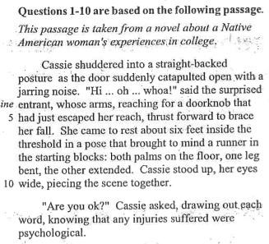
Passage 1-Literature

Slide 4
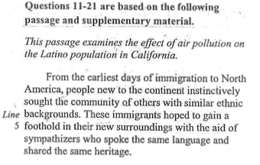
Passage 2-Informational
(environmental science)

Slide 5
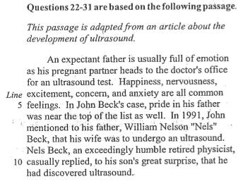
Passage 3-Informational
(medicine)

Slide 6
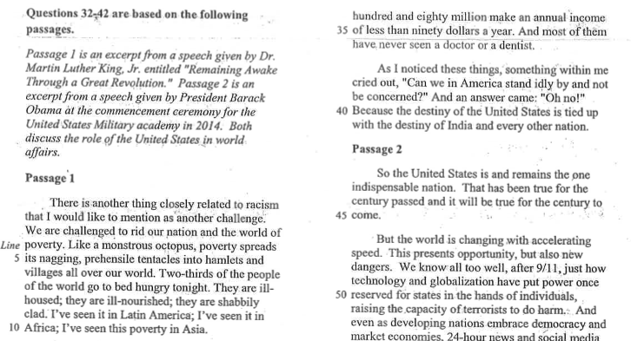
Passage 4-Found Documents
(paired passages-historical speeches)

Slide 7
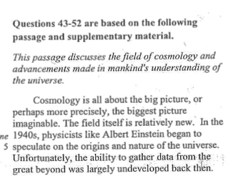
Passage 5-Informational
(science-cosmology)

Slide 8
Question Types
CATEGORY: INFORMATION AND IDEAS
Reading Closely – Determining what’s stated or implied in a passage and applying what you’ve learned from it to a new, similar situation.
Citing Textual Evidence – Deciding which part of a passage best supports either the answer to another question or a given conclusion.
Determining Central Ideas and Themes – Understanding the main point(s) or theme(s) of a passage.
Summarizing – Recognizing an effective summary of a passage or of a part of a passage.
Understanding Relationships – Drawing connections (such as cause/effect, compare/contrast, and sequence) between people, ideas, and the like in a passage.
Interpreting Words and Phrases (Vocabulary) in Context – Figuring out the precise meaning of a particular word or phrase as it’s used in a passage

Slide 9
Question Types
CATEGORY: RHETORIC
Analyzing Word Choice – Understanding how an author selects words, phrases, and language patterns to influence meaning, tone, and style.
Analyzing Text Structure – Describing how an author shapes and organizes a text and how the parts of the passage contribute to the whole text.
Analyzing Point of View – Understanding the point of view or perspective from which passages are told and how that point of view or perspective affects the content and style of the passage.
Analyzing Purpose – Determining the main rhetorical aim of a passage or a part of the passage, such as a paragraph.
Analyzing Arguments – Examining the claims, counterclaims, reasoning, and evidence an author uses in an argument.

Slide 10
Question Types
CATEGORY: SYNTHESIS
Analyzing Multiple Texts (Paired Passages) – Making connections between topically related informational passages.
Analyzing Quantitative Information (Informational Graphics) – Locating data in informational graphics such as tables, graphs, and charts; drawing reasonable conclusions from such graphics; and integrating information displayed graphically with information and ideas in a passage.

Slide 11
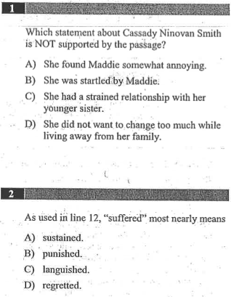

Slide 12
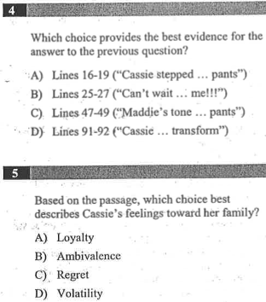
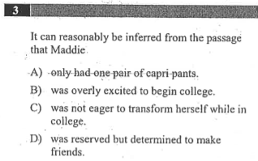

Slide 13
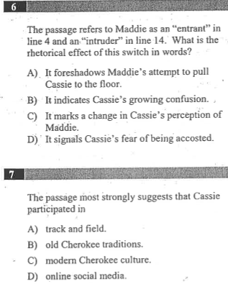

Slide 14
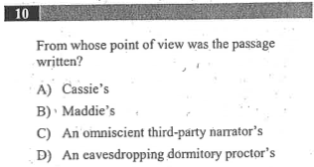

Slide 15
HOMEWORK
Review Section 2 on environmental science (air pollution)
Label each question type. If you think it could count as more than one, list both types.

